Slide 1
2018-2019
Mrs. Hutchinson
Room 128

Slide 3
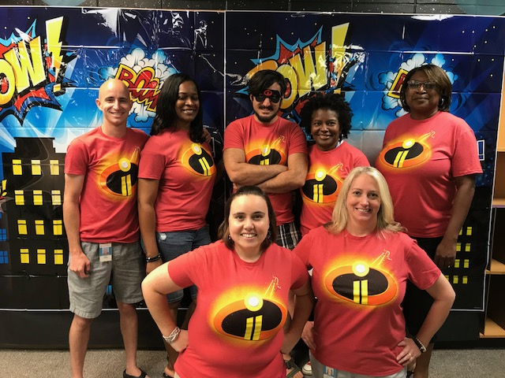
Together we are INCREDIBLE!!r

Slide 4
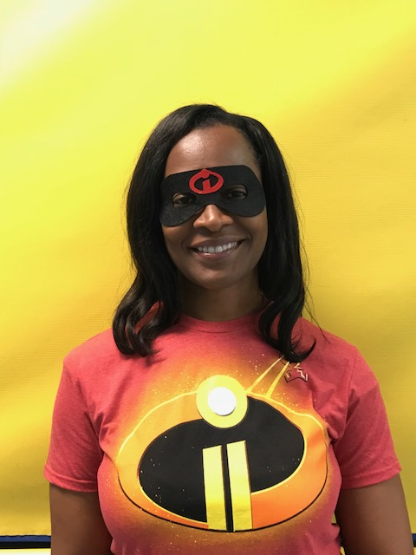
Mrs. Hutchinson
Master’s from Georgia Southern Univ. in Special Ed.
Ed.S. from Nova Southeastern in Curriculum & Admin.
22nd year of teaching/Teacher of the Year in 2002/Highly Qualified in 2006
I am married and have a three year old son, Grayson and four year old daughter, Elyse.
I enjoy watching football, spending time with family, online shopping, and trying new restaurants.
I love teaching and I have your child’s best interest at heart!

Slide 5
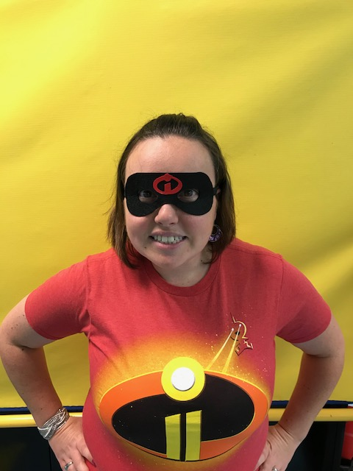
The Amazing Ms. Meyer
I have been working with children on and off for 9 years! I have been with Big Shanty since March 2017 and I love it!! I also head up a ministry for people with Special needs at my church! I'm a huge Disney fanatic and I love photography and Giraffes! An interesting thing about me is that I'm a tap dancer! I just started Hip hop dancing too! In what little free time I have I enjoy going to plays and movies and hanging with my Best friend and her 4 dogs! My favorite quote is from Ben Franklin "Tell me and I forget, teach me and I remember, Involve me and I learn,"

Slide 6
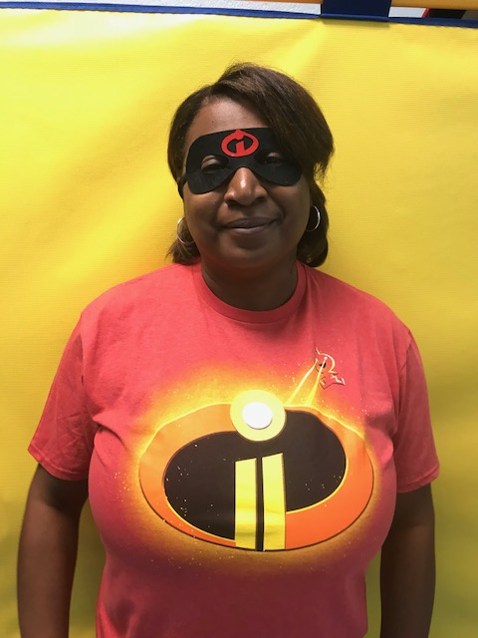
The Outstanding Mrs. Jarmon
I have been married for 25 years to Major Perry Jarmon, Us. Army. I am a mother of five beautiful children and I love spending time with my family.
I am excited to be one of the paras in the classroom this year. You may have seen me around Big Shanty as the ASP director. This is my 4th year in this position. I started out as a sub for two years at Big Shanty. Prior to this I was a stay at home mom.
I love what I do and look forward to working with your child this school year.

Slide 7
7:15-7:30 Arrival/Unpack/Restroom/Daily Folder Check
7:30-8:00 Family Breakfast/ Announcements
8:00-8:30 Restroom/Sensory Break
8:30-9:00 Circle Time
9:00-9:30 Focus Skills /Data Collection/Task Boxes
9:45 Snack/Restroom Break
10:20-11:05 Specials
11:10-11:30 Continue Focus Skills
11:05-11:15 Restroom/Transition to Lunch
112:05-12:35 Lunch
112:45-1:05 Recess
1:05 -1:35 Social Studies or Science
1:35-1:50 Leisure Time (Reading/Computer/Sensory Room) Restroom
1:50-2:00 Clean-up, Daily Folders
2:00-2:10 Pack-up Dismissal

Slide 8
Homework will consist of nightly readings with your child. Please record on reading log provided. This is a school-wide goal.
Big Shanty is committed to assigning HW that is…
Meaningful…
Purposeful…
Intentional…
www.getepic.com

Slide 9
We will have a Letter of the Week each week. Our Friday cooking activity will go along with our letter. We will work on individual goals and objectives during our center rotations.
We will read all things “Pete the Cat” this year!

Slide 10
We will do Calendar Math each morning and continue math in our individual groups. We will work on individual goals and objectives during our center rotations.

Slide 11
Monday: PE
Adapted PE
Weds: PE
Adapted PE
Tues: Music
Thurs: Art
Fri: Media Center

Slide 12
Information will be coming home at a later date about our CBI field trips and other grade level field trips.

Slide 13
Please visit our wish list at
http://a.co/5E444wf
Additional requests will be periodically added to our weekly blog as items from our supply list diminish. We will soon start a coffee cart to help with class needs but will need donations to get started. ☺

Slide 14
Please check the blog weekly for upcoming important dates!
Sept. 14^{th – Back to School Jamboree}

Slide 15
Glenda.Hutchinson@cobbk12.org
Phone: 912-531-4573

Slide 16
ghutchinson.weebly.com
*Please check this site weekly for important information!
I will continue to send photo updates through the SeeSaw App.
See letters in your folders.

Slide 17
Thank you so much for coming today! Thanks for all of your contributions and support. Special & huge thanks to Mr. & Mrs. Edison for the generous donation that allowed for many items from our wish list!

